Slide 1

UNIDAD DOS - ACTIVIDAD UNO Y DOS: MOMENTO INDEPENDIENTE
ASIGNTURA:
Ingles básico
PRENTADO POR
Maura Alejandra Herrera Trujillo
DOCENTE:
Liliana Hernandez

Slide 2

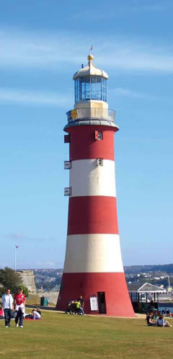

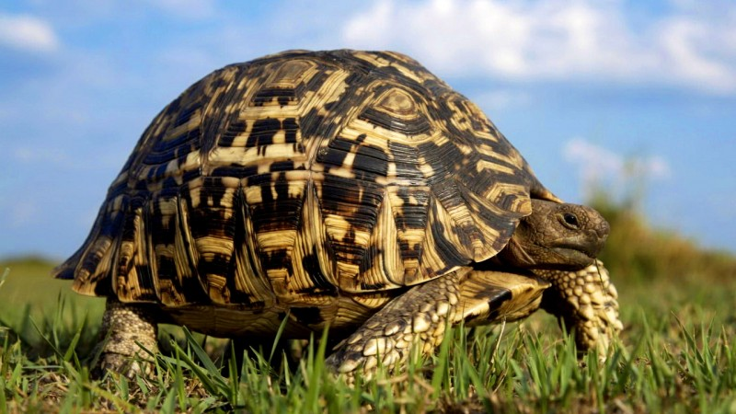
Mayo
It’s a place from which visitors can explore the geography of town, camping and spend some time with friends or family.
Sunday | Monday | Thuesday | Wednesday | Thursday | Friday | Saturday
 |  |  | 1 One | 2 Two | 3 Three | 4 Four
5 Five | 6 Six | 7 Seven | 8 Eight | 9 Nine | 10 Ten | 11 Eleven
12 Twelve | 13 Thirteen | 14 Fourteen | 15 Fifteen | 16 Sixteen | 17 Seventeen | 18 Eighteen
19 Nineteen | 20 Twenty | 21 Twenty one | 22 Twenty two | 23 Twenty three | 24 Twenty four | 25 Twenty five
26 Twenty six | 27 Twenty seven | 28 Twenty eight | 29 Twenty nine | 30 Thirty | 31 Thirty one
Turtles are reptiles with two different types of classes: aquatic and terrestrial. Tortoises are herbivores and aquatic turtles are omníboros. Turtles are animals that prefer to be in well ventilated and humid environments. These animals can reach large sizes between species, from 30 centimeters and up to 1 meter in length. They have a hard shell, which serves as protection. The turtles are oviparous and place their eggs underground, they have 4 legs but they are very slow. They can live hundreds of years.

Slide 3

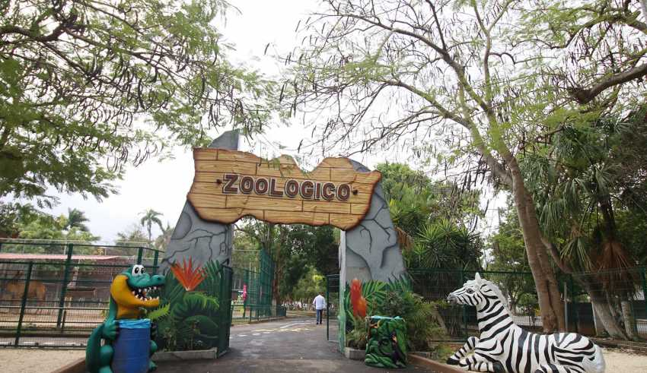
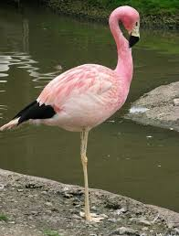

Junio
A friendly place where visitors can share a space with wild animals of all species. One of the biggest attractions in tow
Sunday | Monday | Thuesday | Wednesday | Thursday | Friday | Saturday
 |  |  |  |  |  | 1 One
2 Two | 3 Three | 4 Four | 5 Fiv e | 6 Six | 7 Seven | 8 Eight
9 Nive | 10 Ten | 11 Eleven | 12 Twelve | 13 Thirteen | 14 Fourteen | 15 Fifteen
16 Sixteen | 17 Seventeen | 18 Eighteen | 19 Nineteen | 20 Twenty | 21 Twenty one | 22 Twenty two
23 Twenty three | 24 Twenty four | 25 Twenty five | 26 Twenty six | 27 Twenty seven | 28 Twenty eight | 29 Twenty nine
30 Thirty
Flamingos are beautiful birds, measuring between 80 centimeters and 1.40 meters long, with very long legs and long necks. They inhabit areas surrounded by shallow water. These animals are oviparous and feed mainly on insects, small fish, algae, larvae and other molluscs. Their years of life are between 25 to 30 years of life in their natural habitats.

Slide 4
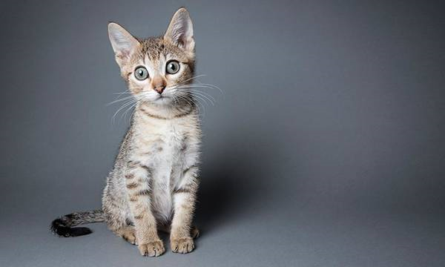
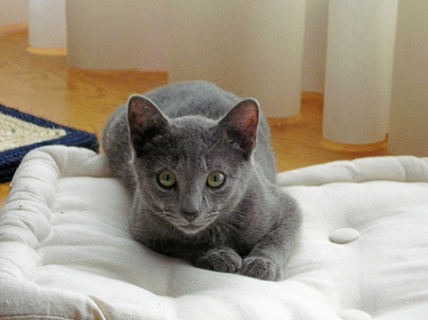
Actividad 2 My pet
My pet is a cat. The cat is a small animal, mainly carnivorous. As a pet or pet is very popular and, in addition, it is appreciated as a mouse hunter has retractable nails, apart from good smell and hearing, excellent night vision.
My cat is beautiful, her name is Luna, she is 2 years old. She is gray in color, has light green eyes and is very soft and tender, she also has long mustaches.
She likes to jump, roll and hide in every corner, she is very agile like every cat. But what makes him special is that he is obedient and always listens to me, I love his caresses and howls. I love my cat and I'm sure he loves me.
Audio: https://drive.google.com/open?id=141hSaZjPmp0FMdKrcZAFEDKW1C1TInru

Slide 5

Mi mascota
Mi mascota es un gato. El gato es un animal pequeño, principalmente carnívoro. Como animal doméstico o mascota es muy popular y, además, es apreciado como cazador de ratones tiene uñas retráctiles, aparte de buen olfato y oído, excelente visión nocturna.
Mi gata es hermosa, su nombre es Luna, tiene 2 años de edad. Ella es de color gris, tiene ojos verdes claros y es muy suave y tierna, también tiene bigotes largos.
A ella le gusta saltar, rodar y esconderse en cada esquina, es muy ágil como cada gato. Pero lo que lo hace especial es que es obediente y siempre me escucha, me encantan sus caricias y aullidos. Amo a mi gata y estoy seguro de que él me ama.

